Slide 1
Welcome to the Workshop!
Find a seat with a nametag, and plug in!
WiFi instructions are on the white board
Make sure you’ve completed the setup
https://uw-madison-aci.github.io/2018-08-27-uwmadison-dc/#setup
And the pre-workshop survey
https://www.surveymonkey.com/r/dcpreworkshopassessment?workshop_id=2018-08-27-uwmadison-dc
Say ‘Hi’ to the other people at your table

Slide 2


Welcome to
@
https://uw-madison-aci.github.io/2018-08-27-uwmadison-dc/

Slide 3
Instructor/Helper Introductions

Slide 4
Workshop Content

Slide 5
Data Problems*
"Where did this data file come from?!”
"Can you repeat the analysis, omitting subject X?”
“You used the wrong data- the full dataset has more subjects.”
“The color-coding in this spreadsheet was off.”
*modified from Karl Broman’s intro to Tools for Reproducible Research

Slide 6
Our Goal: Reproducibility
Learn data analysis tools and best practices for organizing your data
Two themes:
Plan ahead: take time to organize and document
Avoid doing things “by hand”: use tools that parse and analyze data, rather than editing data directly
Take away something immediately useful
Pick one thing you learned to implement right away

Slide 7
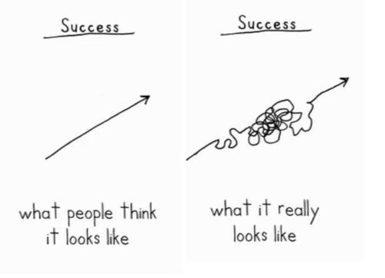

Slide 8
What We’ll Learn
Data Organization and Formatting in Spreadsheets
Data Cleaning/Reformatting
(Meta: Tips for Data Entry/Creation)
Data Management using a Database
Automated Data Analysis
Automated Data Visualization and Reporting

Slide 9
Tools We’ll Use
Spreadsheet Program (Excel, or other)
Open Refine
SQL
R w/packages:
dplyr
ggplot2
knitr

Slide 10
Workshop Logistics

Slide 11
Workshop Format
Hands-on, working with real data.
Be prepared to:
follow along with the instructor on your own computer
work on exercises by yourself or with people near you
Ask questions!
Share notes in the etherpad:
https://pad.carpentries.org/2018-08-27-uwmadison-dc

Slide 12
Nametags
Your nametags are a visual feedback tool for instructors
If you are lost, confused, or need help, put the red side up.
If all is well, put up the green side up.

Slide 13
Code of Conduct
In order to facilitate the best learning for everyone, we expect everyone to abide by the Data Carpentry Code of Conduct: http://www.datacarpentry.org/code-of-conduct/ If you have any concerns, email Christina at ckoch5@wisc.edu or Sarah at sarah.stevens@wisc.edu, or contact the Carpentry staff listed on the CoC above.

Slide 14
Other Logistics
We will have breaks during the morning, afternoon and for lunch.
Coffee, tea, and morning snacks are provided, lunch is on your own.
We can provide a refrigerator / microwave for food.
Restrooms (and drinking fountains) are across the hall or on the first floor.

Slide 15
Meet your neighbors!
Talk to 1-2 people around you by:
summarizing your research/work in three words (and then briefly describe it)
sharing one thing you hope to learn at this workshop

Slide 16
Important Links
Workshop website (schedule, materials):
https://uw-madison-aci.github.io/2018-08-27-uwmadison-dc/
Etherpad (links, online notes + live chat):
https://pad.carpentries.org/2018-08-27-uwmadison-dc
Twitter: @thecarpentries, #dcuwm
Notes:
Trigger Warning

Slide 17
Portal Dataset
Notes:
Sothern AZ

Slide 18
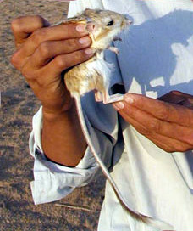
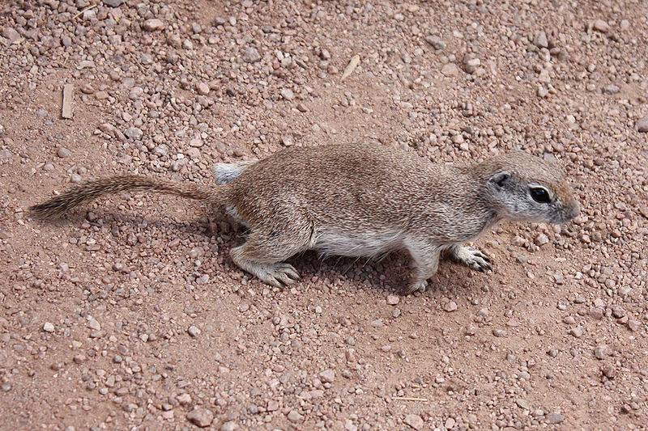
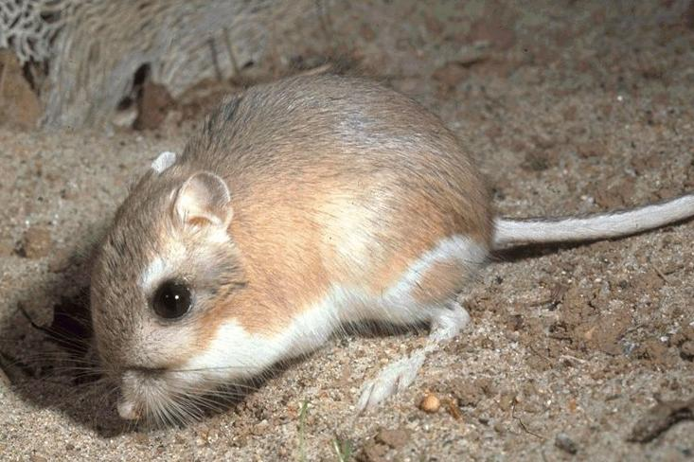
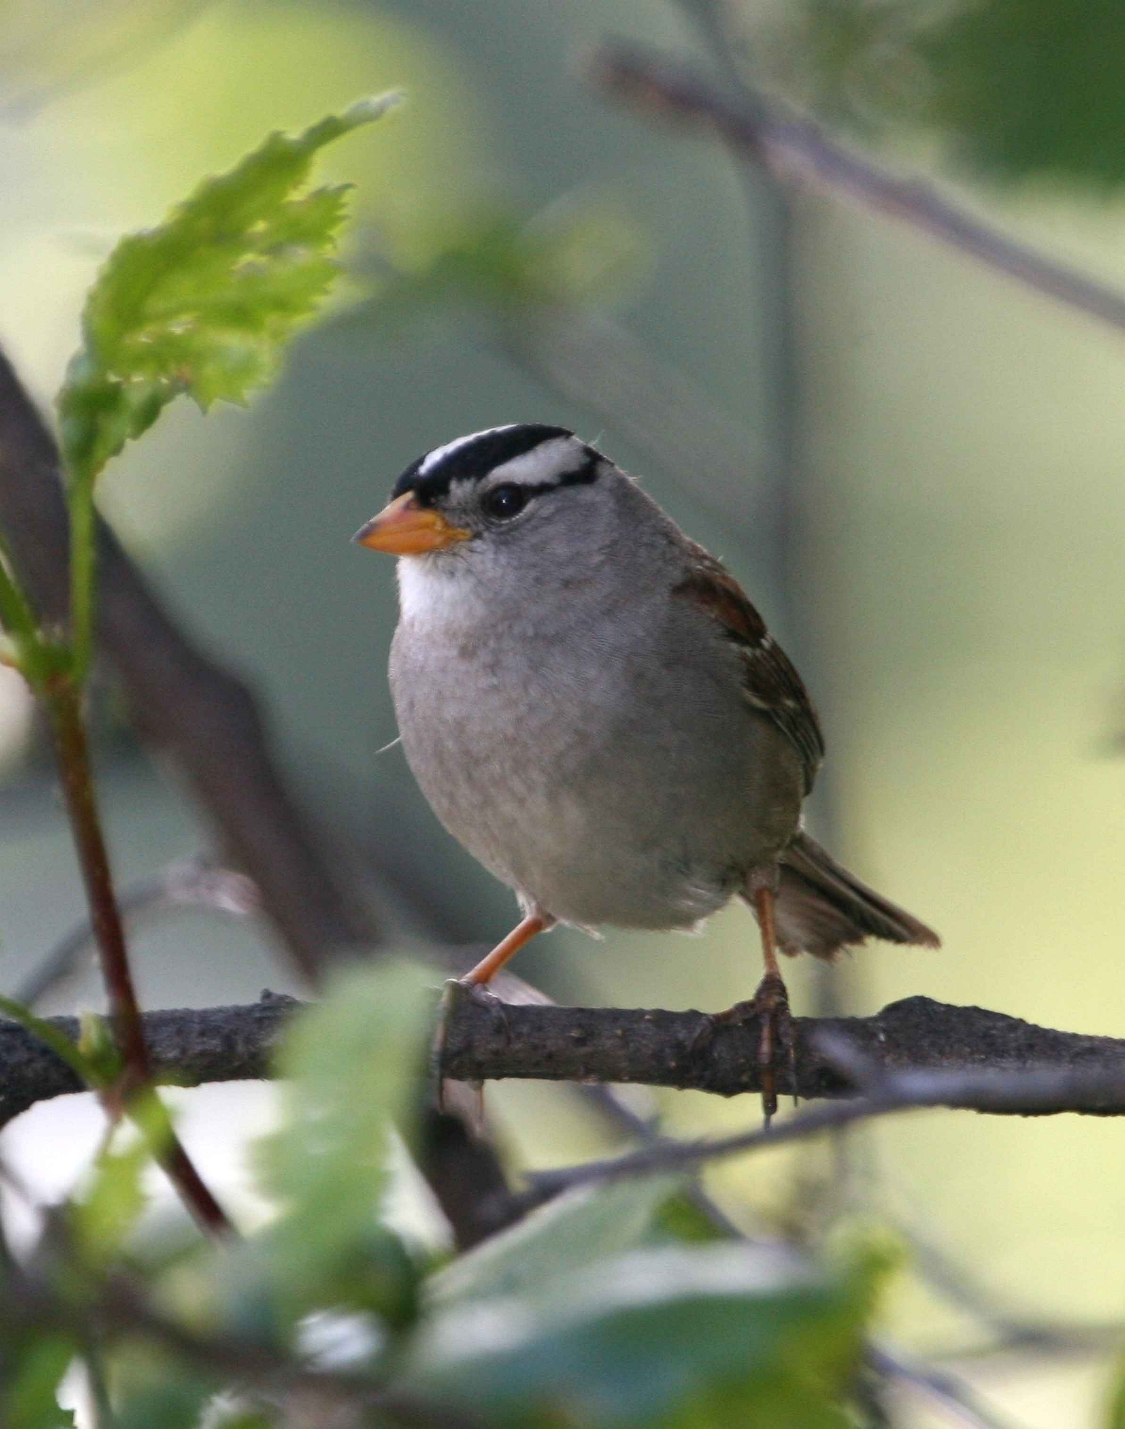
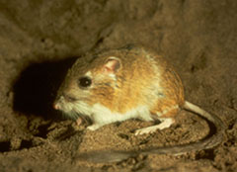
Creatures!
Notes:
All public domain photos

Slide 19
Intro to the Portal Dataset
Tabular dataset
Observations of small mammals
Collected over more than 40 years
24 plots of a desert ecosystem in Arizona
Different experimental manipulations controlling which rodents are allowed to access which plot
Real dataset, but simplified
Notes:
This is part of a project studying the effects of rodents and ants on the plant community that has been running for almost 40 years. The rodents are sampled on a series of 24 plots, with different experimental manipulations controlling which rodents are allowed to access which plots.
This is a real dataset that has been used in over 100 publications. We’ve simplified it just a little bit for the workshop, but you can download the full dataset and work with it using exactly the same tools we’ll learn about today.

Slide 20
Questions
Is there a difference between the weight of male and female kangaroo rats?
Do different species of kangaroo rats have different hindfoot lengths?
How does hindfoot length relate to weight the weight of a kangaroo rat?
How does the number of Kangaroo rats that get into the enclosure change over time?
Is there a difference in the number of kangaroo rats that get into the different enclosures?

